Slide 1
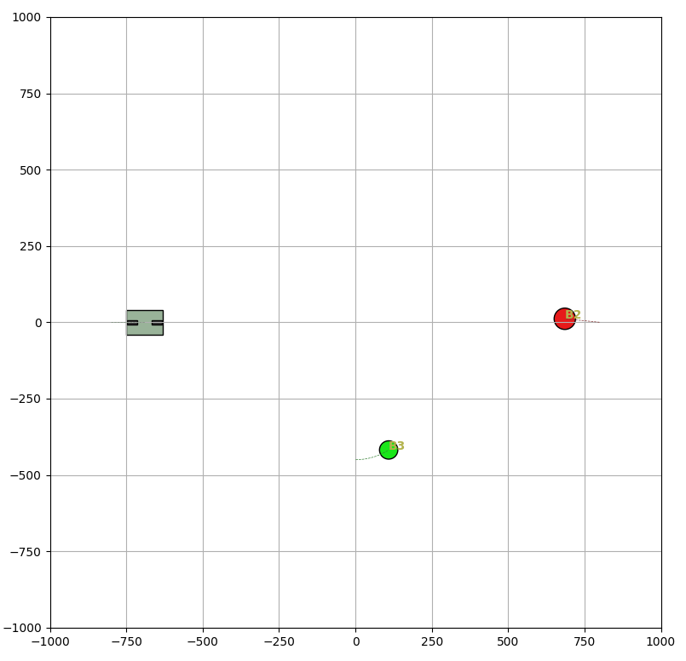
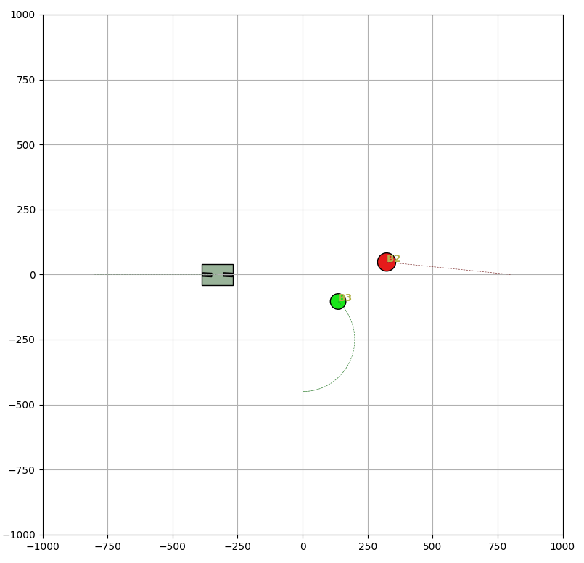
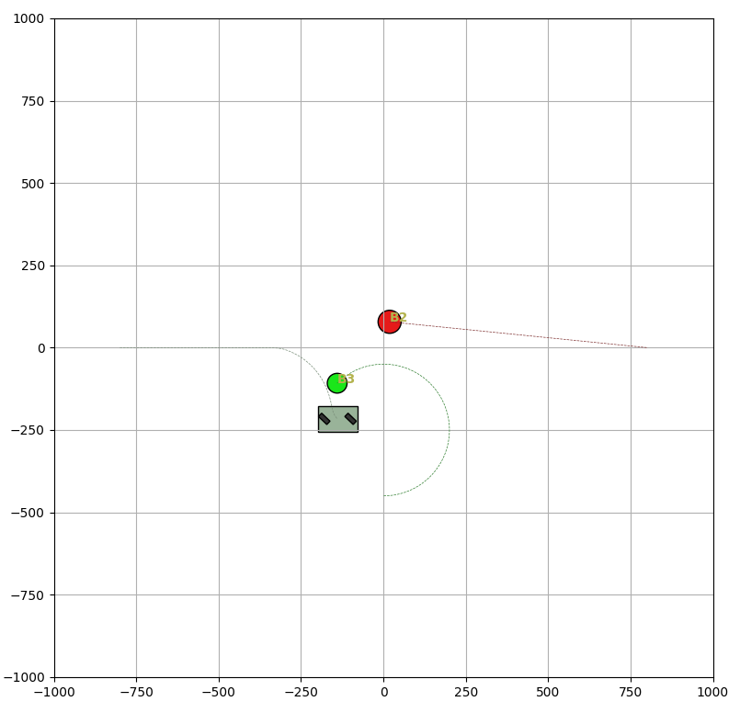
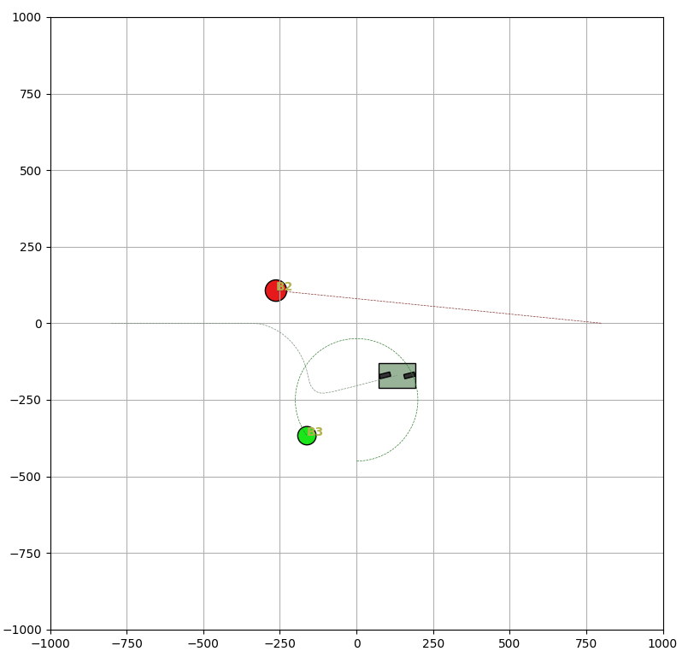
Predictive Velocity Obstacle Method for Mobile Robot Motion Planning Among Dynamic Obstacles with Unknown Intentions
Nowadays, with Autonomous Mobile Robots (AMRs) being increasingly deployed in many field such as industry, their motion planning in dynamic and complex environments has become a critical challenge.
This study employs a multi-step optimization framework based on the Velocity Obstacle (VO) method, aiming to determine the optimal sequence of velocity commands for an AMR to effectively avoid dynamic obstacles with unknown intentions. The entire process is structured into three key components: Prediction, Optimization, and Movement, each playing a crucial role in enhancing the robots’ navigation capabilities in dynamic environments.
Robot
Obstacles

Slide 2
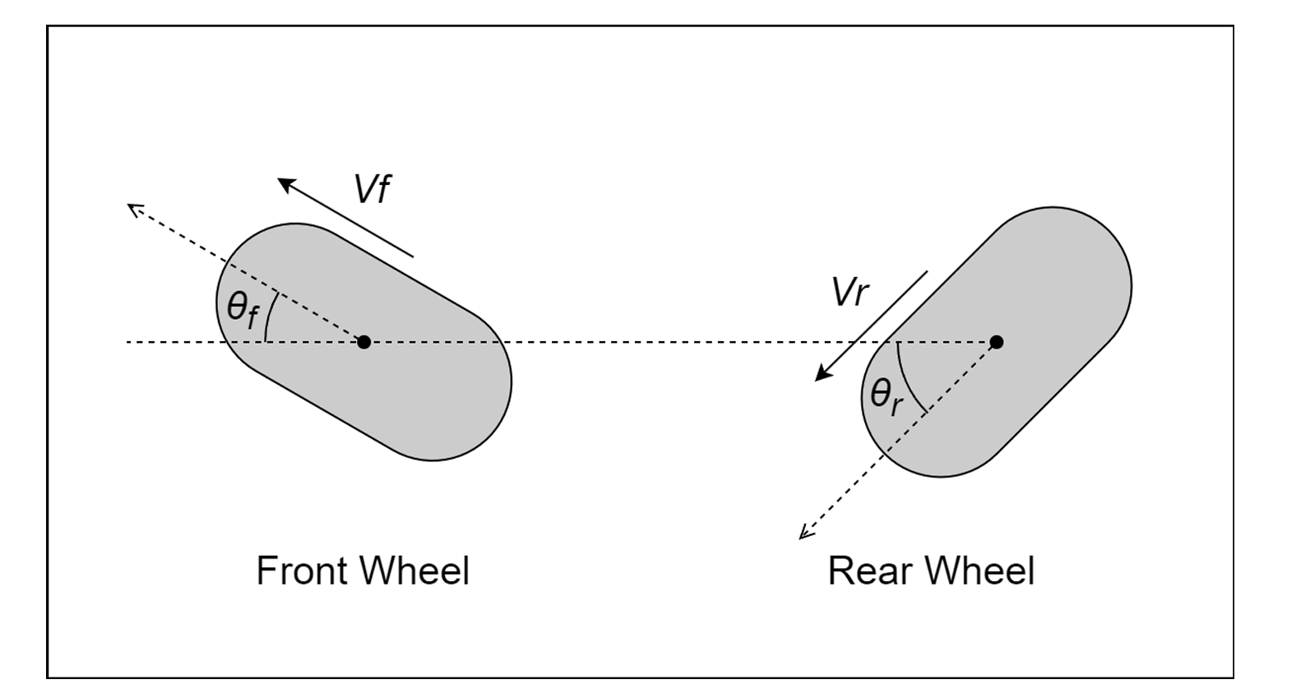
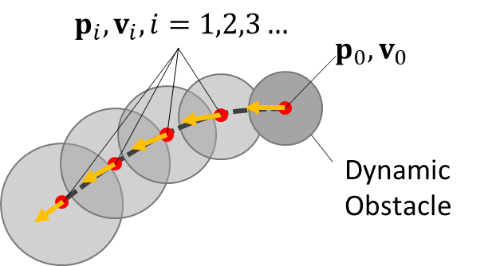
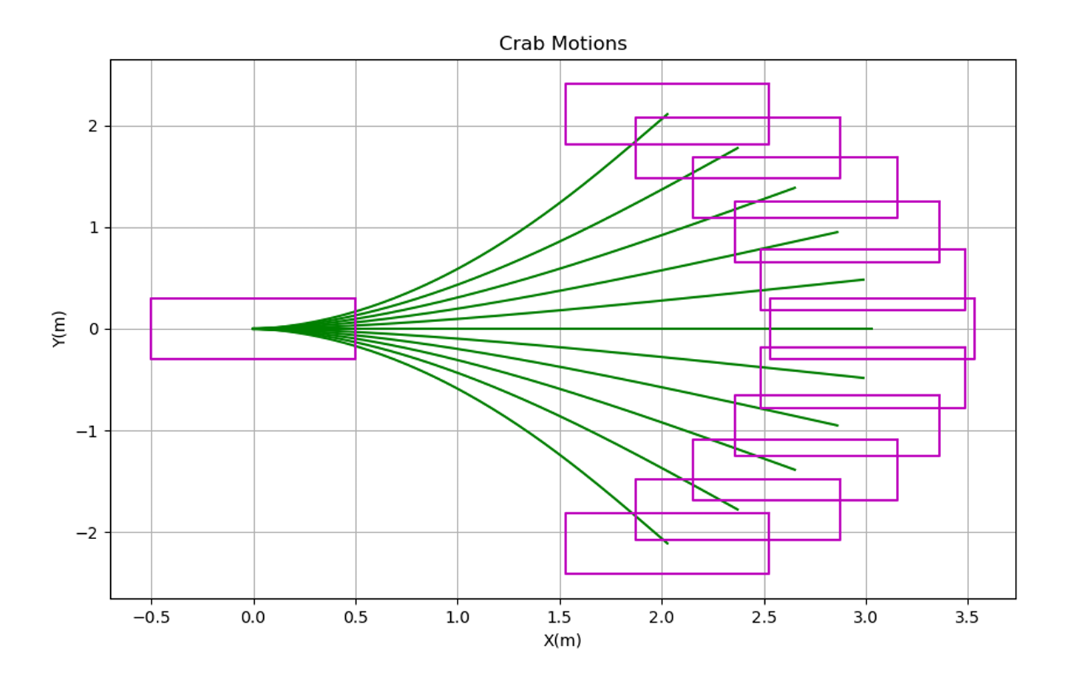
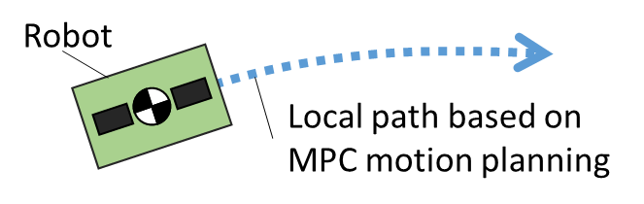
Prediction
Optimization
Move
To anticipate potential collisions, the system predicts the future positions and velocities of dynamic obstacles using a Kalman Filter combined with a Constant Acceleration Model. Additionally, the variations in these predictions are evaluated to account for uncertainties in motion.
A multi-step optimization process is employed to generate the robot’s future velocity commands:
Objective Function: Determines optimal velocity sequences over multiple time steps while ensuring smooth transitions, following the principles of Model Predictive Control (MPC).
Constraints: Constructs Velocity Obstacles (VO) in the robot’s velocity space based on the predicted obstacle parameters, enabling real-time collision avoidance.
The algorithm is implemented on a Generalized Bicycle Model (GBM), a holonomic robot platform. Unlike conventional non-holonomic systems, GBM decouples orientation from heading, allowing the robot to adjust its movement direction independently of its orientation.
GBM

Slide 3




$$p_{i},v_{i}, i=1,2,3…$$
$$p_{0},v_{0}$$
Dynamic Obstacle
$$p_{i},v_{i}, i=1,2,3…$$
$$p_{0},v_{0}$$
Dynamic Obstacle
Robot
Local path based on MPC motion planning

